Slide 1
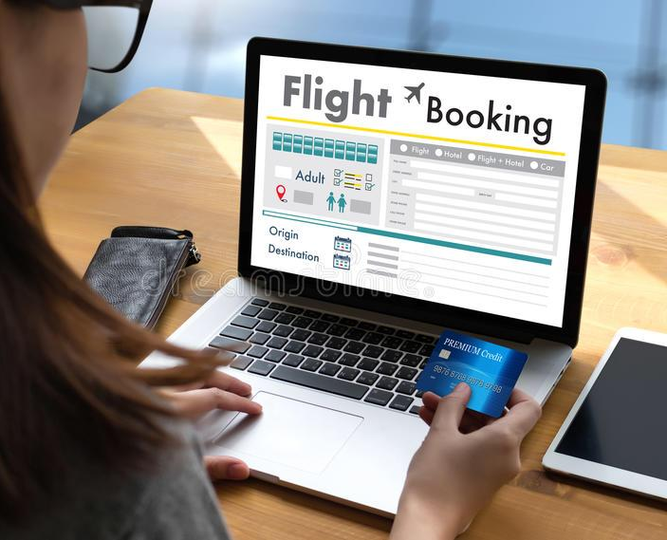
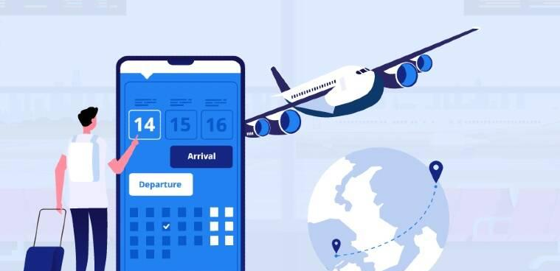
Online Air Tickets Booking System for SkySail (Pvt) Ltd
Group ID – Y2_S2_WE_TW22

Slide 2

AGENDA
Introduction
Problem Statement
Motivation
Benefits of the system
System overview
System Functions
Tools and Technologies
Work Distribution

Slide 3


BACKGROUND
SkySail is an online platform for booking airline tickets, hotels, and rental cars.
It offers a user-friendly interface that allows customers to search, compare and book flights from a wide range of airlines based on various criteria such as price, airline, departure time, and flight duration.
The platform provides real-time availability and pricing information and ensures a hassle-free experience by offering secure payment options and customer support throughout the booking process.
SkySail is a convenient and reliable one-stop-shop for all travel needs.

Slide 4

PROBLEMS
Compatibility issues: Apps need to work seamlessly across multiple devices, operating systems, and screen sizes. Compatibility issues can arise when an app is not optimized for a specific device or operating system, leading to crashes, glitches, and poor performance.
Security vulnerabilities: Apps can be vulnerable to security breaches, leaving user data and sensitive information at risk. Developers need to implement robust security measures, such as encryption and two-factor authentication, to protect user data.
User experience (UX) issues: UX issues can include poor navigation, slow loading times, and confusing layouts. A poor user experience can lead to low user engagement and negative reviews.
Technical glitches: Bugs and technical issues can occur during the development process, leading to crashes and glitches in the app. Testing and debugging are essential to ensure that the app runs smoothly and efficiently.

Slide 5

MOTIVATIONS
Solving a problem: Apps can be developed to solve specific problems, such as increasing productivity, improving communication, or streamlining processes.
Innovation: Developers can be motivated to create new and innovative apps that offer unique and exciting features, such as augmented reality or artificial intelligence.
Business opportunities: Apps can provide lucrative business opportunities, such as monetization through in-app purchases or advertising.
Personal interests: Some developers are motivated by personal interests, such as developing apps related to their hobbies or passions.

Slide 6
SOLUTION OVERVIEW
Compatibility issues
Use cross-platform development tools
Develop for specific devices and operating systems
Use responsive design techniques to ensure apps work across different screen sizes
Security vulnerabilities
Implement strong encryption techniques
Use two-factor authentication
Regularly test and audit the app for vulnerabilities
User experience (UX) issues
Conduct user research and testing to understand user needs and preferences
Use a simple and intuitive design
Ensure fast loading times and smooth navigation
Technical glitches
Use automated testing tools to identify and fix bugs
Regularly update and maintain the app with bug fixes and feature enhancements

Slide 7




BENEFITS OF THE SYSTEM
Comparison Shopping
Convenience
Flexibility
Savings
Real time data

Slide 8
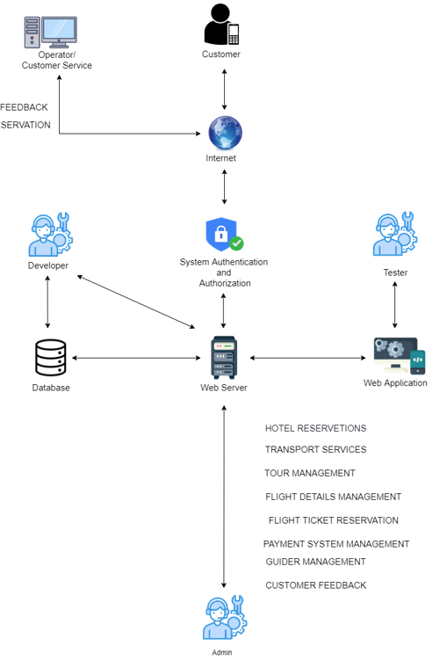
SYSTEM OVERVIEW

Slide 9
METHODOLOGY - AGILE
Planning: In this phase, the project team defines the goals, requirements, and scope of the app. The team creates a product backlog, which is a prioritized list of features and tasks required to develop the app.
Design: In this phase, the team designs the app architecture, user interface, and user experience. The team creates wireframes, prototypes, and mockups to test and refine the design.
Development: In this phase, the team develops the app, using an iterative approach to add features and functionality. The team uses automated testing tools to identify and fix bugs and technical issues.
Testing: In this phase, the team conducts testing to ensure the app is functional and meets the requirements and expectations of the target audience. The team uses manual and automated testing to identify and fix bugs and issues.
Deployment: In this phase, the team deploys the app to a live environment. The team monitors the app's performance and usage and makes updates and improvements based on feedback.
Maintenance: In this phase, the team provides ongoing support and maintenance to ensure the app remains functional and secure. The team uses analytics and user feedback to identify opportunities for improvement and adds new features and functionality as needed.

Slide 10

FUNCTIONS OF THE SYSTEM

Slide 11
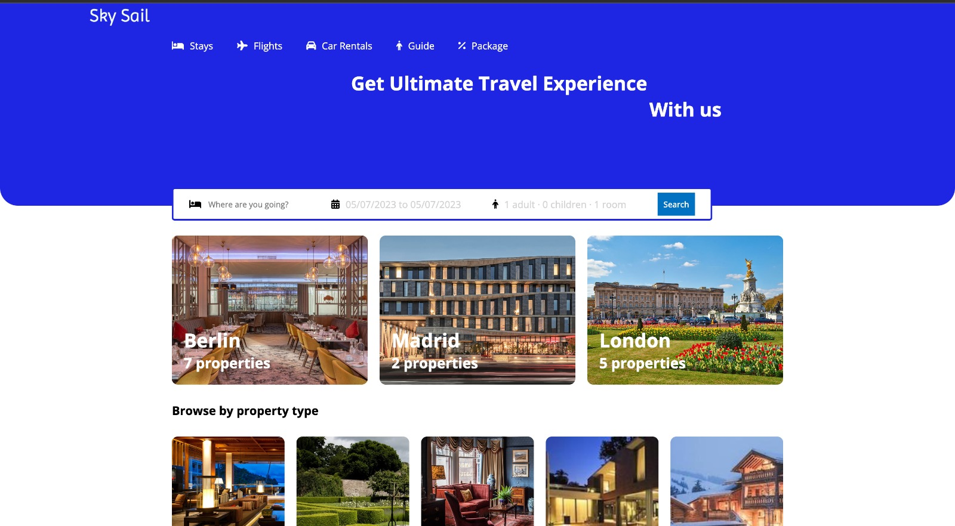
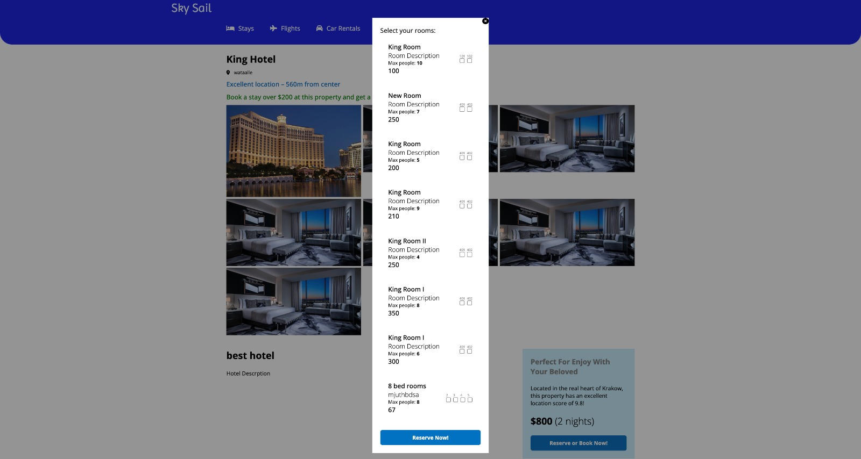
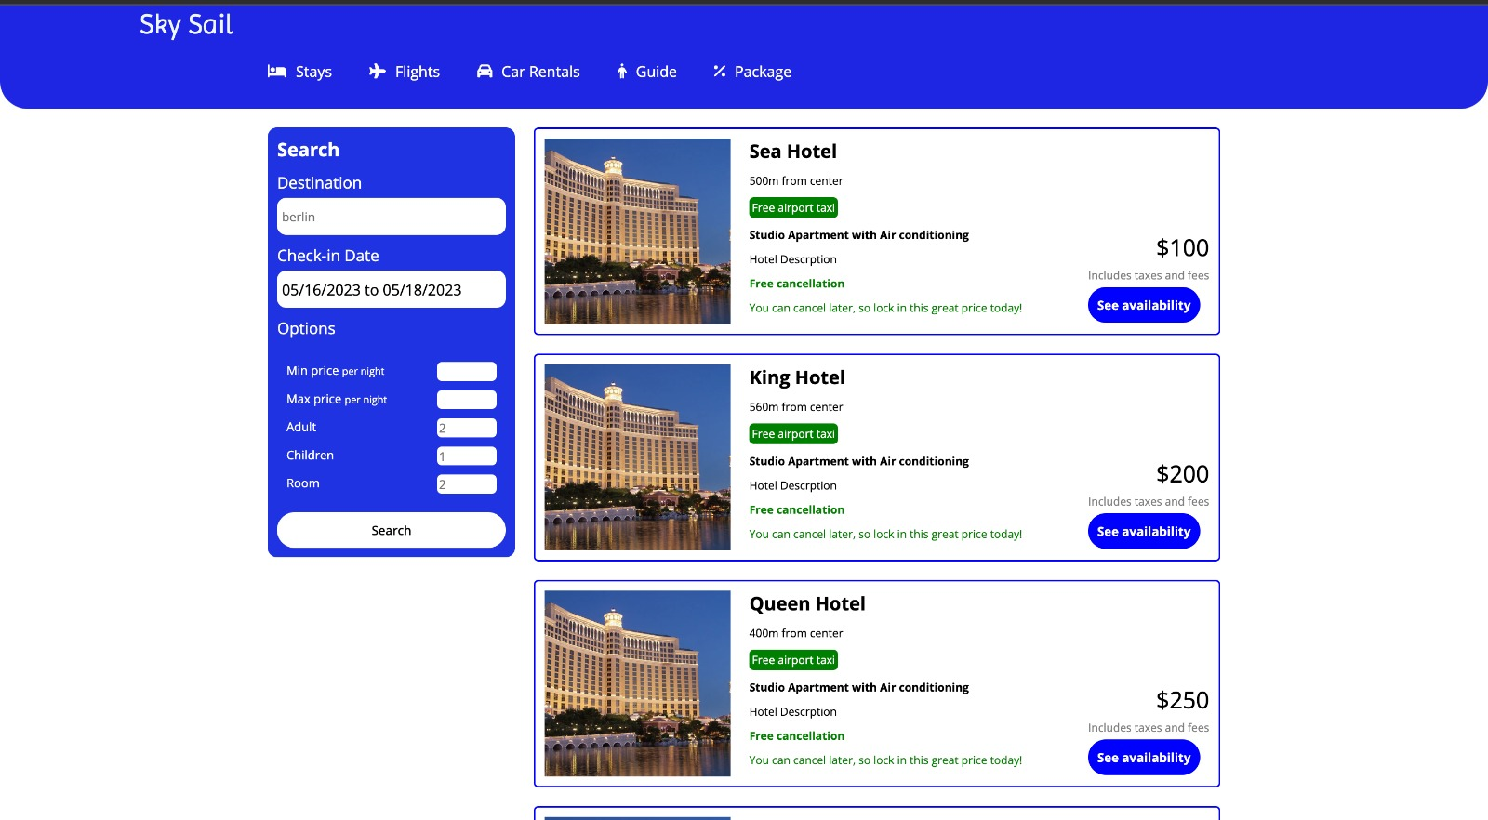
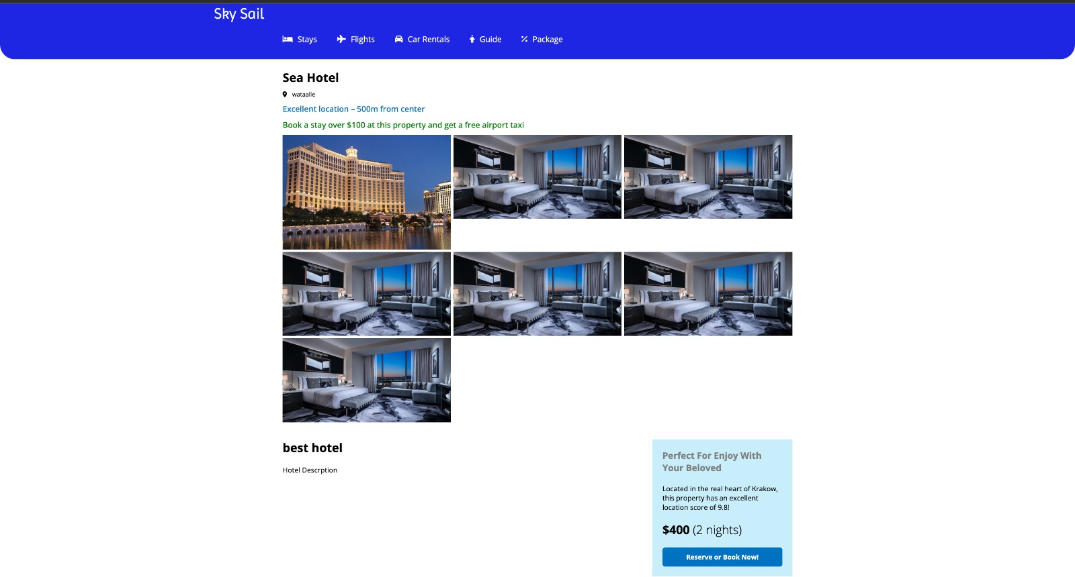
HOTEL RESERVETIONS
An online hotel booking system provides efficient, effective, and compliant operations to manage and monitor a hotel's data, customer bookings, and functions for a satisfactory guest experience
1.Admin Management:
• Managing hotel information
• Updating new hotel information
• Deleting hotel information
• Report generation
2.Customer Management:
• Viewing hotel information
• Searching nearby hotels
• Reserving hotels

Slide 12
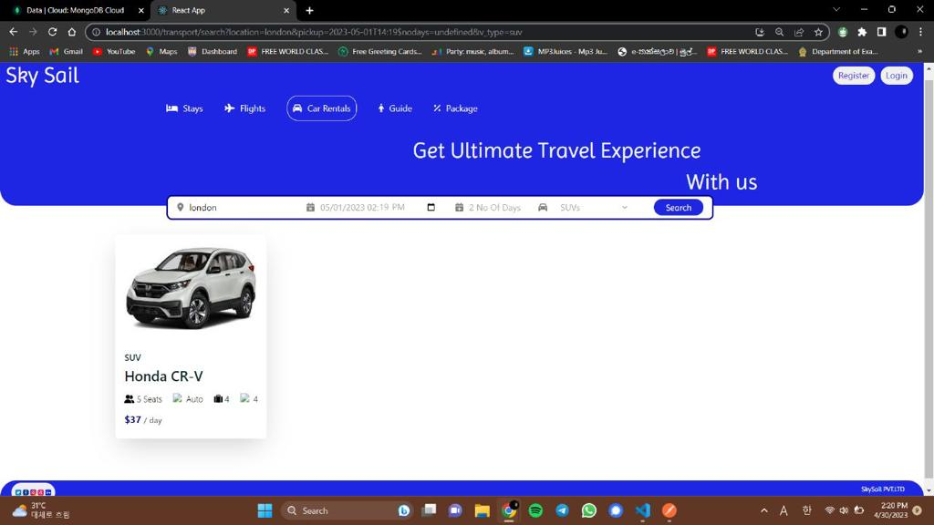
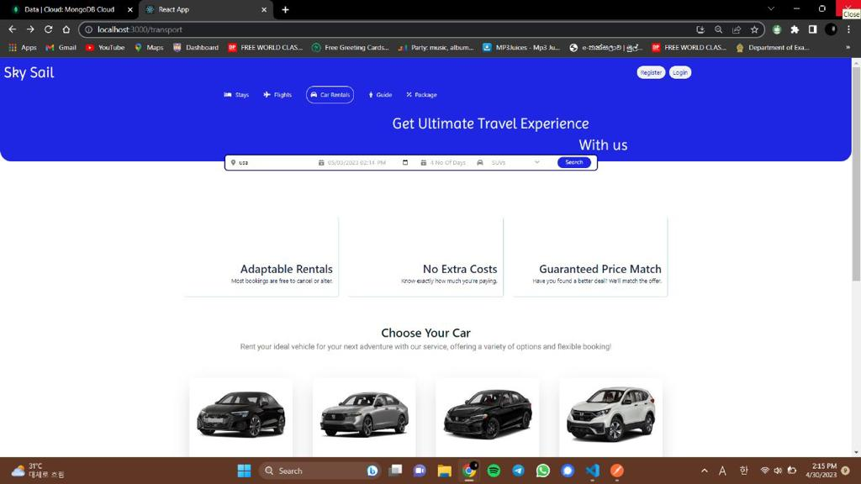
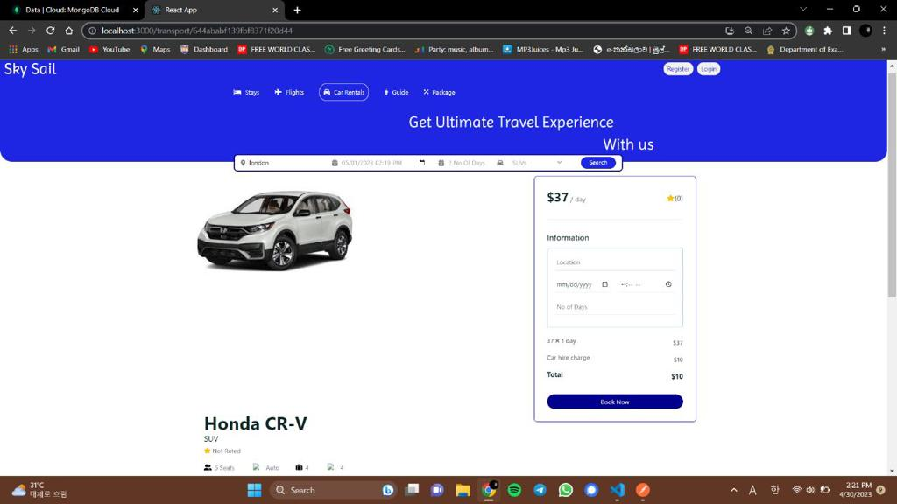
TRANSPORT SERVICES
We provide a safe and efficient transportation experience for passengers and drivers, with features such as ride scheduling,
• Managing rides
• Real-time tracking
• Payment processing
• Ratings
• Safety features
• Driver Management

Slide 13
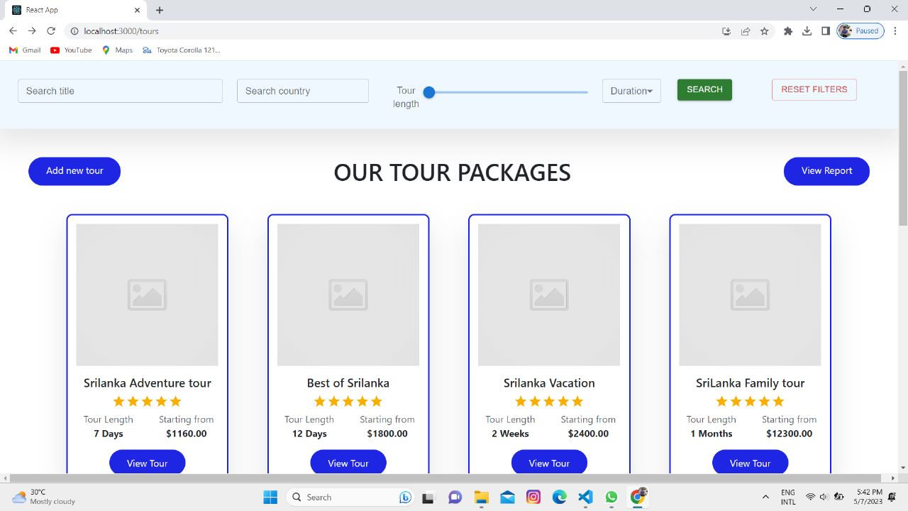
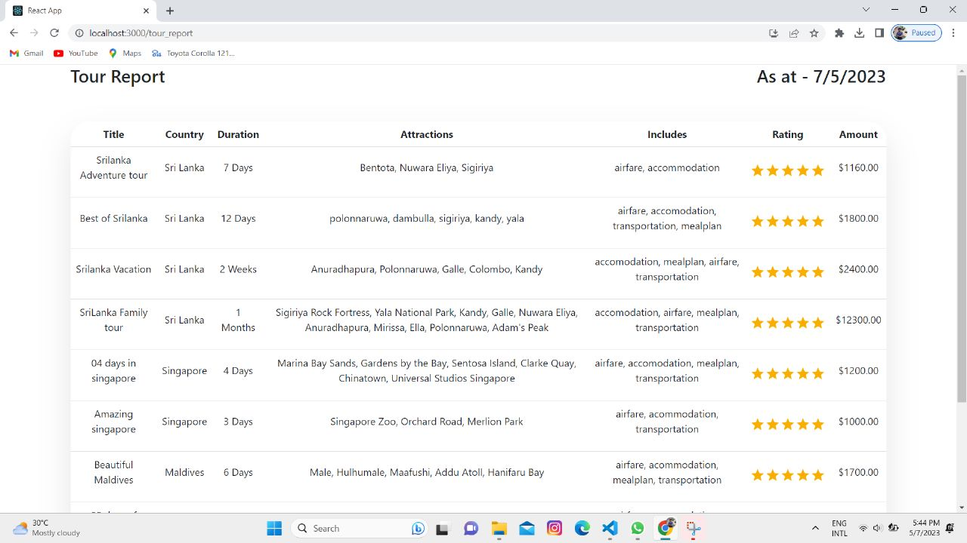
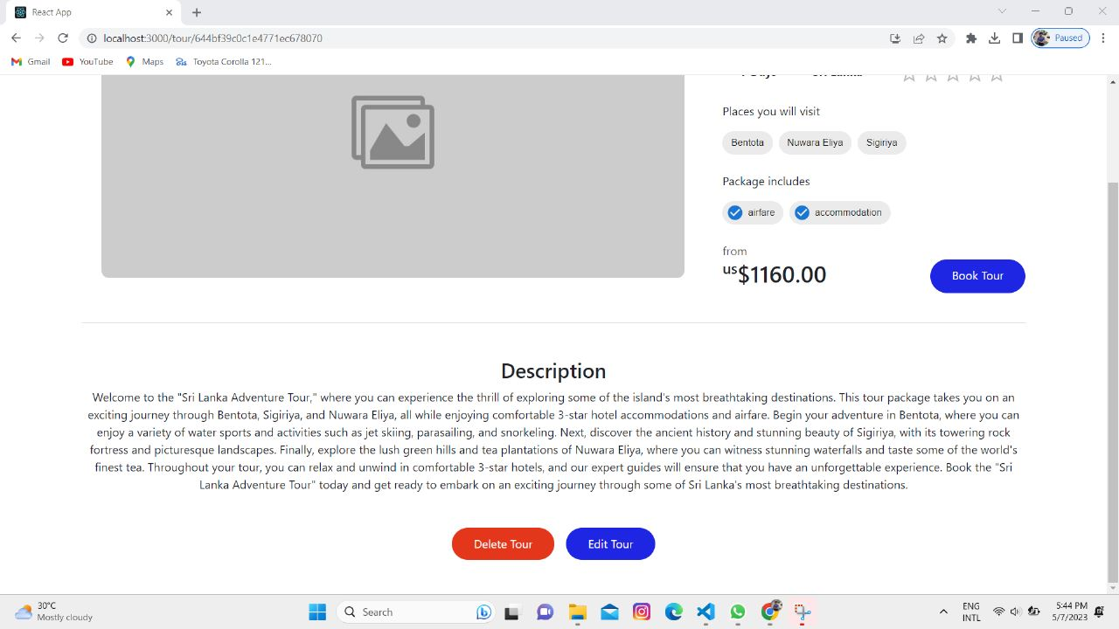
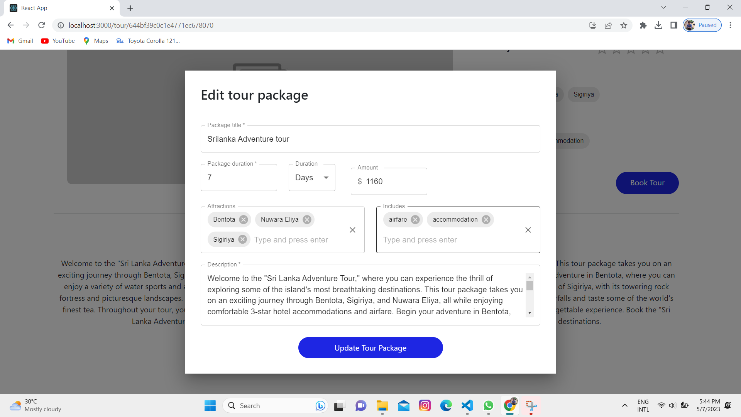
TOUR MANAGEMENT
• Create new tour packages
• Update the details of the tour packages
• View tour packages
• Delete existing tour packages

Slide 14
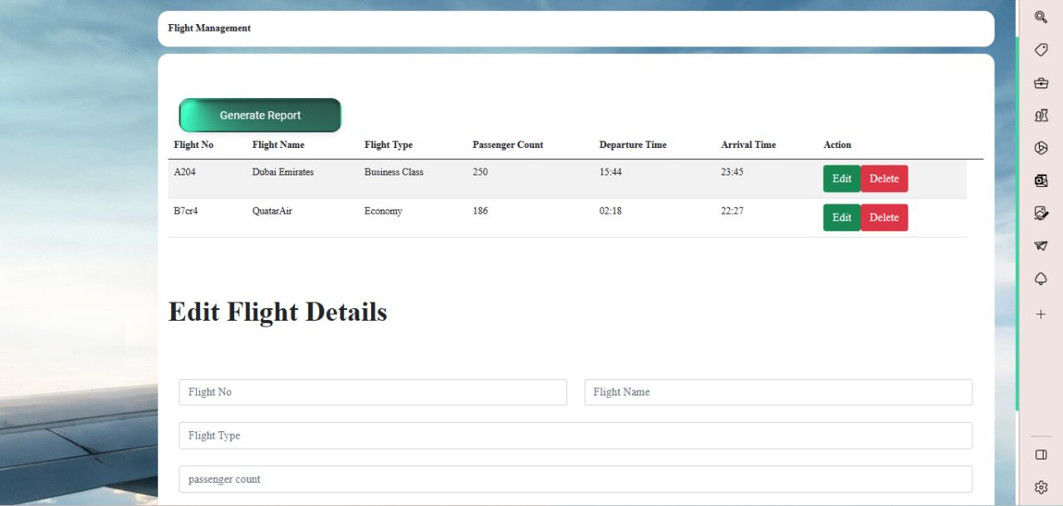
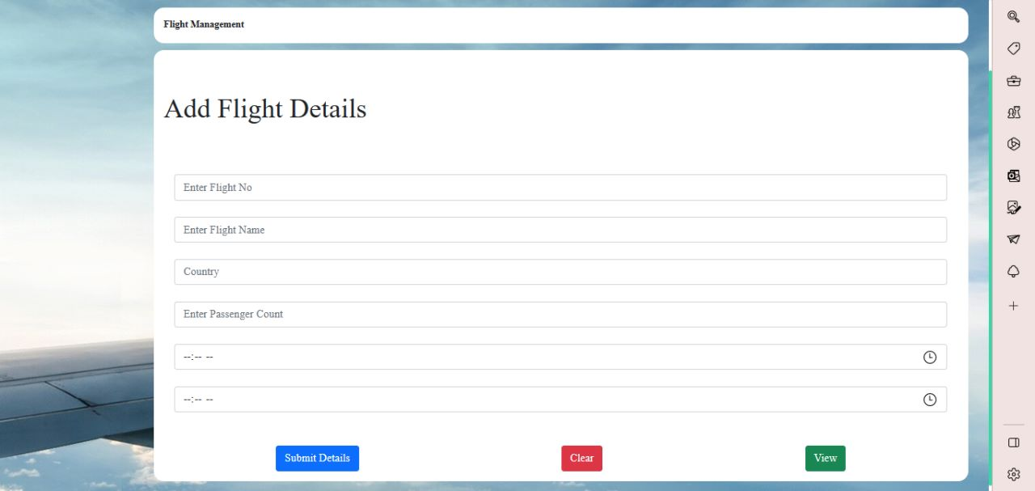
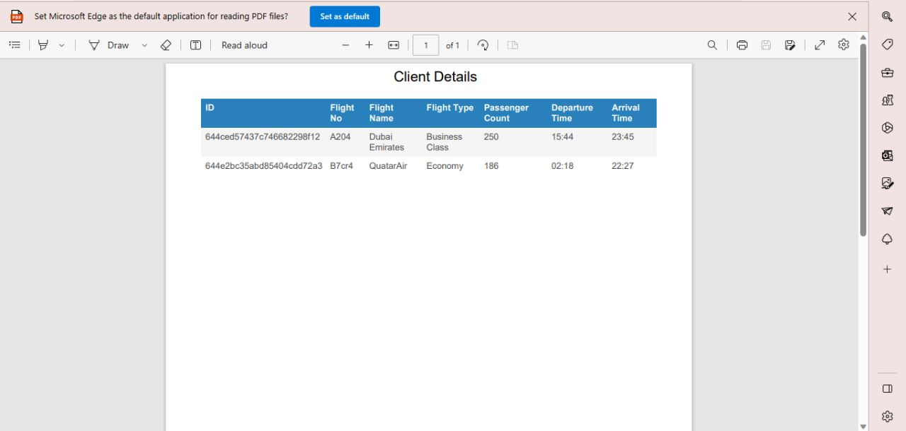
FLIGHT DETAILS MANAGEMENT
Admin Maintain un updated flight schedule
Customer makes inquiries.
Admin Manage customer’s inquiries.
Admin Reserve seats for customers

Slide 15

FLIGHT TICKET RESERVATION

Slide 16
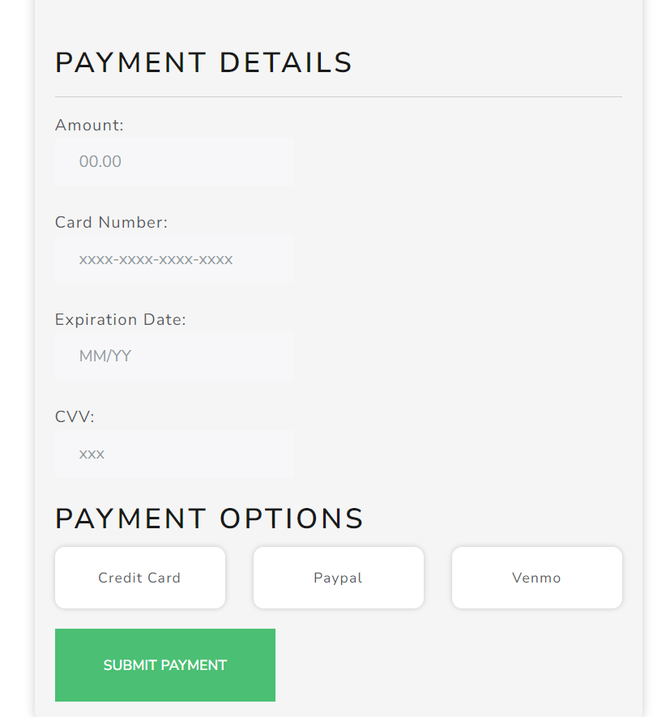
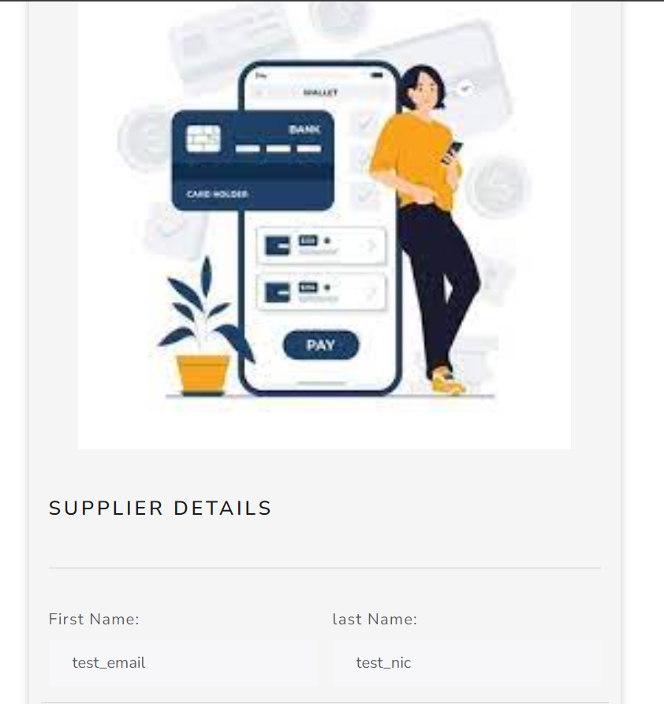
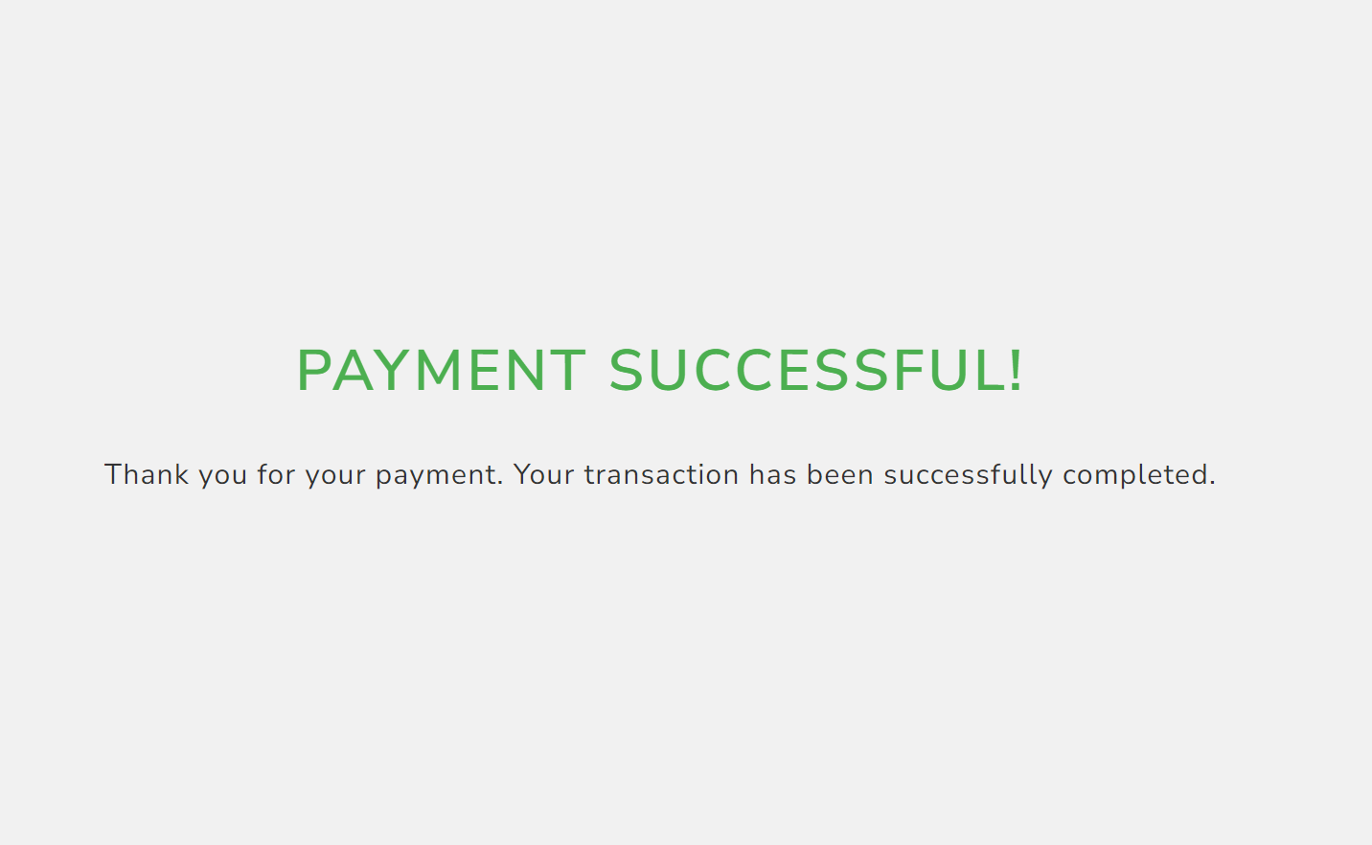
PAYMENT SYSTEM
Payment Gateway Integration
Payment Processing
Fraud Detection and Prevention
Payment Reconciliation
Payment Refunds and Cancellations
Compliance with Regulations
Reporting and Analytics

Slide 17
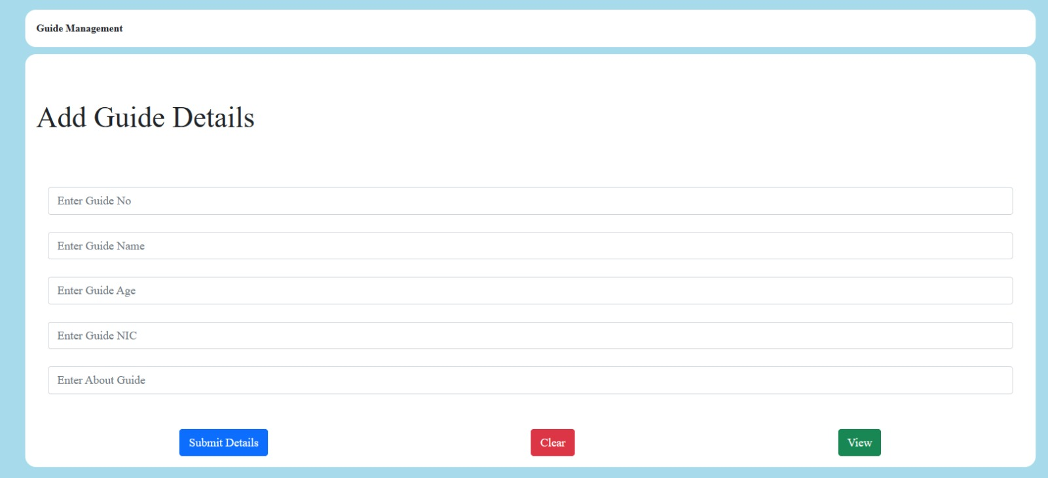
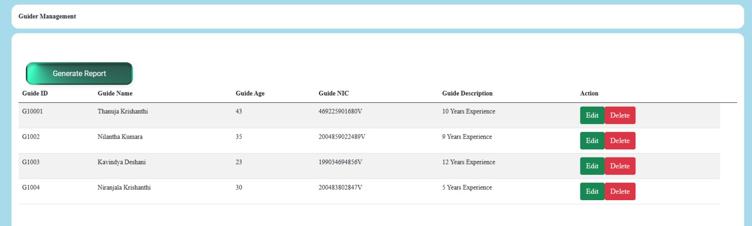
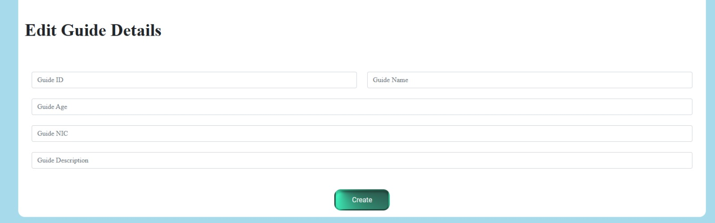
GUIDER MANAGEMENT
Admin give guider details
Admin show guider profile
Customers can communicate with guider directly
Enquiries can be updated or deleted depending on customer preference

Slide 18
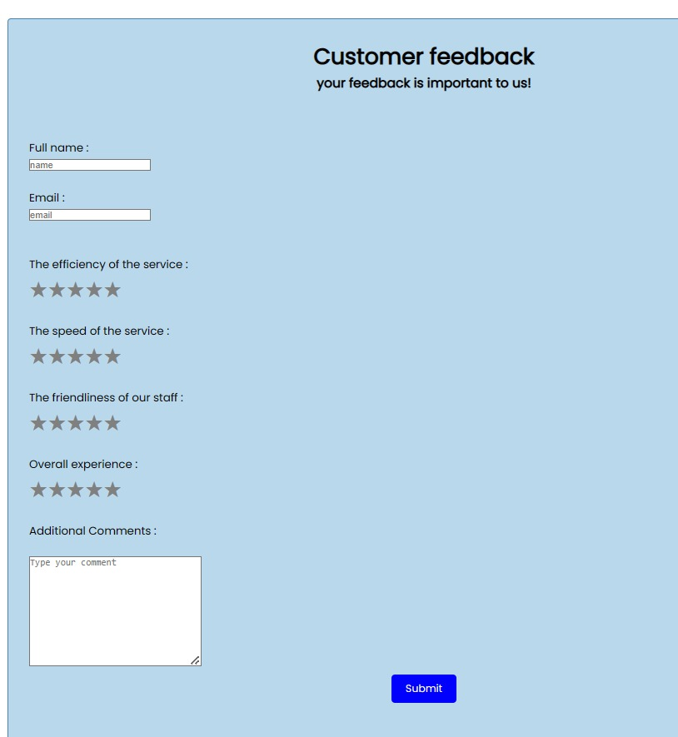
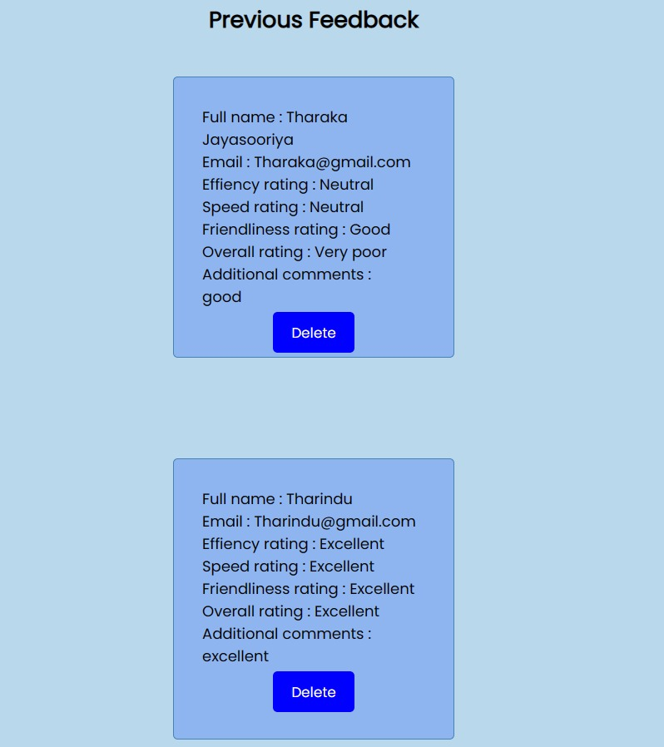
CUSTOMER FEEDBACK
Improving product and service quality by feedback analysis
Enhancing customer satisfaction and increase in loyalty.
Monitor performance and address issues.
Identify trends and stay competitive.
Better understanding of customer needs and higher engagement.

Slide 19





TOOLS AND TECHNOLOGIES
Visual Studio Code is the platform we used to develop the coding.
Source code management, team collaboration, and version control are managed using GitHUB.
MongoDB is the database program we use for this web application.
With React Js we code the front-end interface.
Node Js encodes the back-end.

Slide 20

WORK DISTRIBUTION

Slide 21

Name with Initials | Work Allocated
Withanachchy Y.R | Introduction Client/Company background System Overview Implementing “Payment system management” Making the final document
Yeshmantha W.N | Making the “Problem statement” Implementing “Hotel reservation” system
Fernando W.A.T.A | Making “Solutions” for the problem statement Implementing “Transport services” system
Chamika H.A.S.C | Benefits of proposed solutions Implementing “Flight detail management”

Slide 22

Arthigan A | Implementing “Flight ticket reservation” Making the Gantt chart
Vishvanath M.S.M.V | Implementing “Tour Management” Making the Gantt chart Making the Gantt chart summery
Jayasooriya J.A.T.N | Implementing “Customer feedback” Tools and Technologies/summery
Hitinayaka.H.M.N.M | Implementing “Guider management”

Slide 23

THANKS FOR FLYING WITH US !!!

